Slide 1

Welcome to the session Introduction to Internet of Things: Build your own Smart Device
Notes:
Put slide in Slideshow mode in one desktop.
Open Folder that contains the code in VS Code.
Screen share whole screen.

Slide 2
Agenda
Introduction to IOT
Building your own smart device
Other project ideas
Notes:
Hi everyone, This is Aswin Prasad. I am here today to give you an introduction about IoT and then a quick tutorial to build your IoT device using Raspberry Pi, sensors, a little bit of programming, and finally I will talk about the possibilities of what can be done further with IoT.
The session contents will be available in our materials library website, feel free to use the website to get access to the video and references mentioned in this session and the github link for the project will also be there.

Slide 3
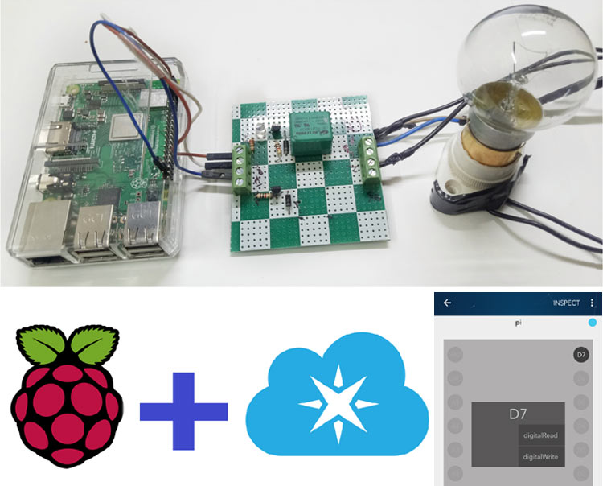
Introduction to iot
Notes:
Basically, the Internet of Things is a concept in which there will be physical devices that are connected to the internet and they collect data from or output data to the world. These devices include everything from phones, smartwatches, smart home devices. Many devices that once had only physical interfaces are connected to internet and are part of Internet of Things.

Slide 4
Required Hardware
Raspberry Pi with Micro SD card and Raspbian OS loaded.
Micro LED bulbs
Jumper wires
Bread board
Monitor (To be used as a display).

Slide 5
Build your own smart device
Notes:
1. Now, I am going to explain to you how you can create your smart home device. For this, we are going to have a web page, which will be used to control a led bulb.
2. The bulb can be either switched on or off based on the user input in the webpage.

Slide 6
Build your own smart device-sections
Setting up Raspberry Pi
Web page part
Python programming part
NodeJS server part
Raspberry Pi connections
Notes:
Here are some of the sections that I will be covering now.

Slide 7
Setting up raspberry pi
https://projects.raspberrypi.org/en/projects/raspberry-pi-setting-up

Slide 8
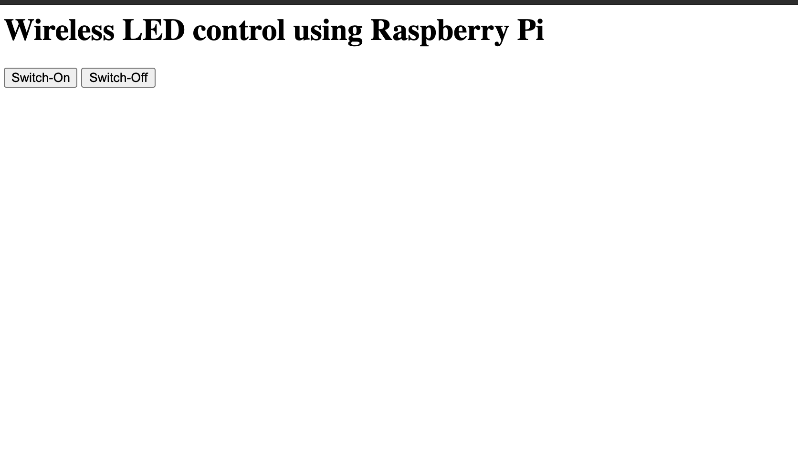
Web page

Slide 9

Python programming

Slide 10
Nodejs server

Slide 11
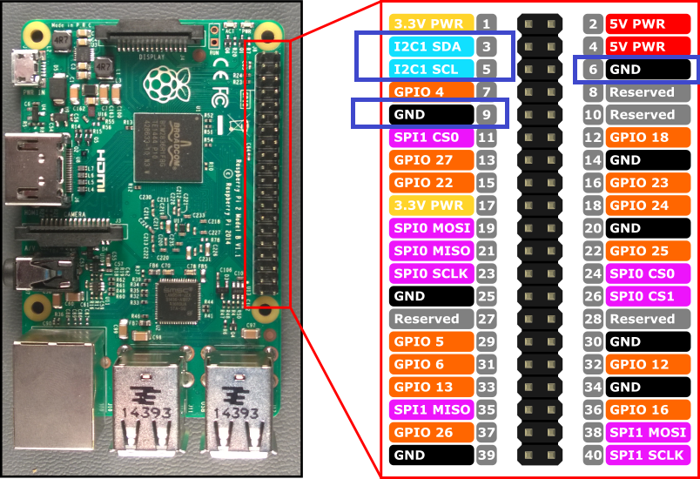
Raspberry pi connections
Notes:
Raspberry pi has 40 pins that can be connected to devices to give / get instructions. Some of them are Ground pins, some voltage and other Input ports.

Slide 12
Demo video

Slide 13

Other project ideas
Project links: (https://nevonprojects.com/iot-projects/)
Notes:
The Internet of things doesn't stop here, there are endless possibilities of what can be done with IoT. You can build an automatic light control for your house, thermostat for your house that can be controlled with your homes, etc...
You can always get these devices in Amazon, but building them yourself with these sensors will give a sense of understanding and satisfaction for anyone who does that.

Slide 14
Links
1. https://www.raspberrypi.org/help/what-%20is-a-raspberry-pi/
2. https://ubidots.com/blog/building-a-people-counter-with-raspberry-pi-and-ubidots/
3. https://nevonprojects.com/iot-projects/
4. https://www.amazon.com/eBoot-Pieces-Emitting-Diodes-Assorted/dp/B06XPV4CSH/ref=sr_1_3?crid=2OYJVO0PDODCY&dchild=1&keywords=led+diodes&qid=1600764878&sprefix=led%2Caps%2C221&sr=8-3
5. https://www.amazon.com/EDGELEC-Breadboard-Optional-Assorted-Multicolored/dp/B07GD2BWPY/ref=sr_1_3?crid=3NR1T5Z4FIRJR&dchild=1&keywords=jumper+wires&qid=1600764924&sprefix=jump%2Caps%2C222&sr=8-3
6. https://github.com/aswinpchn/Task
Notes:
Here are some references that will be helpful to you. There is a Github link which contains the code part that is used in this session.

Slide 15
Thank you
Precautions
Questions
Notes:
Don't connect electric devices directly along with your IoT setup as the system we are developing is not tested thoroughly and can be harmful. You can try small utilities that interest you.

